Slide 1

COEN 6312
MODEL DRIVEN SOFTWARE ENGINEERING
Karishma Jesrani(27276281)
Sukhveer Kaur (27192304)
Shalom Paul (27495994)
Manpreet Singh(27197055)
Het Shah(27184913)
BY
TEAM- BLEED BLUE

Slide 2

Introduction
Purpose
Use Cases
Class Diagram
OCL Constraints
State Diagram
Action Specification
Code Demo
Tools Used
Collaboration
Challenges & Lessons Learnt
Conclusion
Future Work

Slide 3

Vision
Online Real Estate System- allows users to Buy and Sell Properties.
Clean Design to model the system.
Learn and apply concepts studied
Use of new plugin Papyrus to create code from domain model

Slide 4
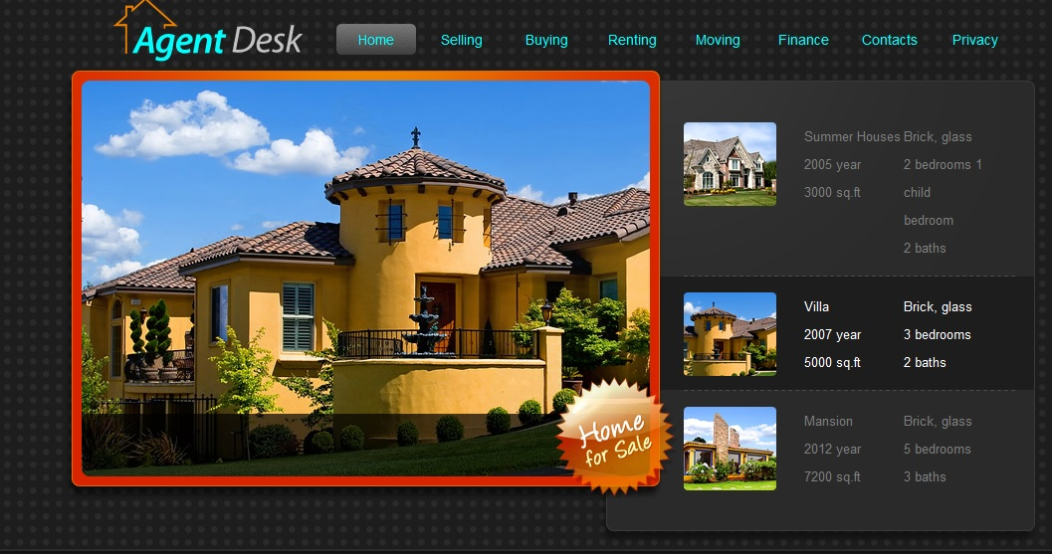

Slide 5

Concept
A 24*7 running system.
Secure and fast browsing.
System should run on any operating system.
Respond as per user request
User friendly

Slide 6

Project Functionalities
Various kinds of properties to choose from.
User can select either to buy or rent the property.
User can contact the Admin by sending and receiving messages.
He/ she can filter the properties based on his/ her required type, location, size, price, etc.
The user can make an offer on the property.
The admin can activate or de-activate the user.
The admin can post, edit, delete advertisements.
The admin can contact any user on the site.

Slide 7
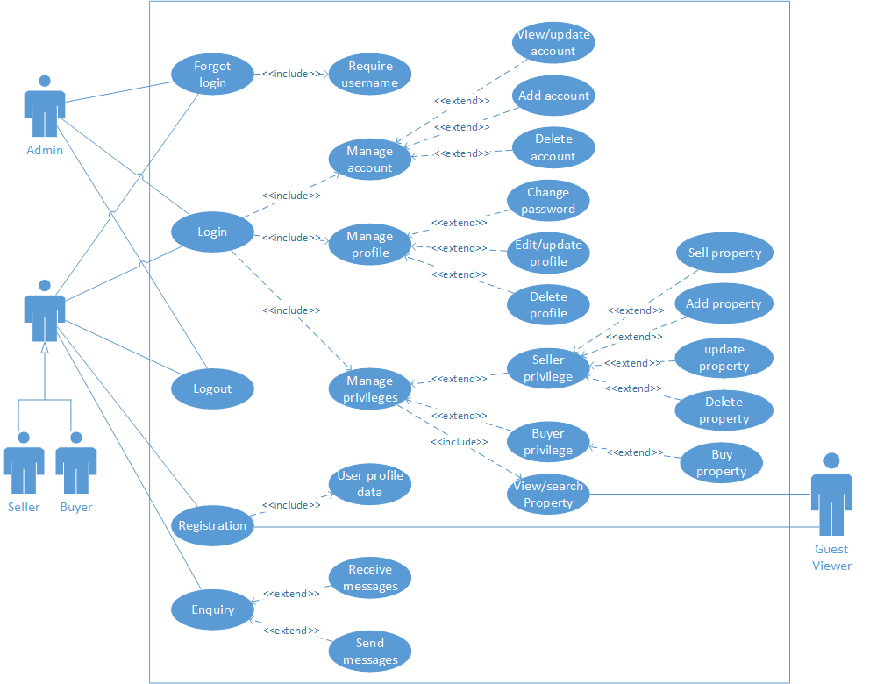
Use Case Diagram

Slide 8
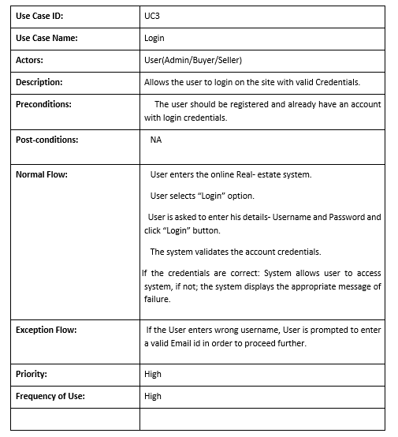
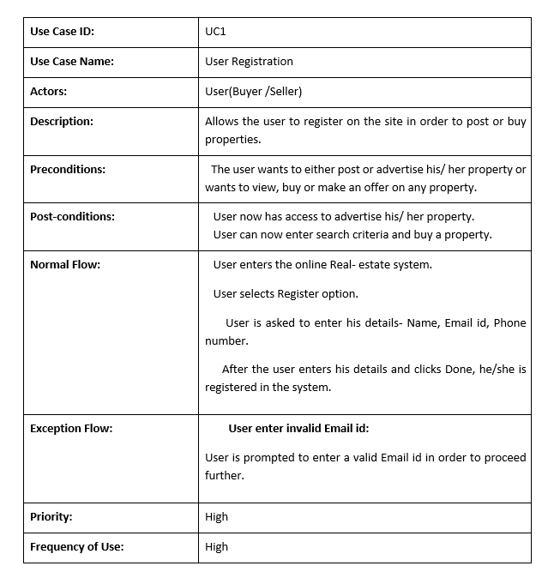
Fully Dressed Use Case

Slide 9
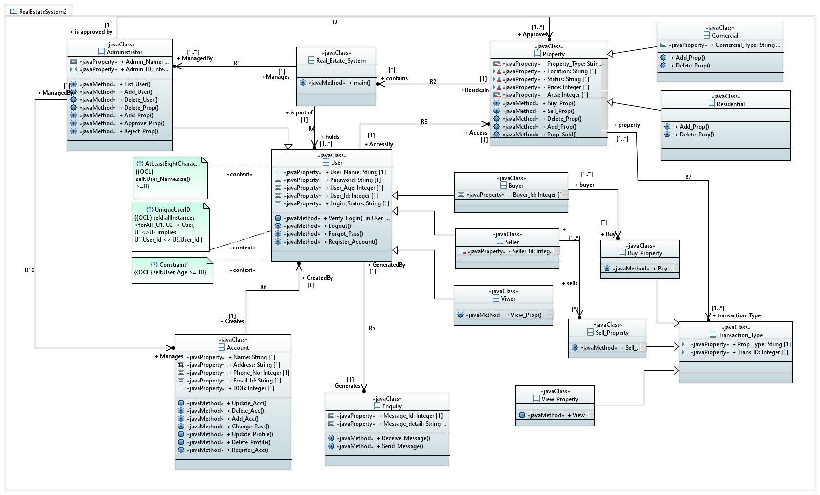
Class Diagram

Slide 10
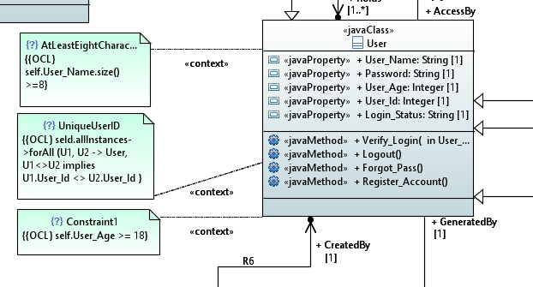

Slide 11
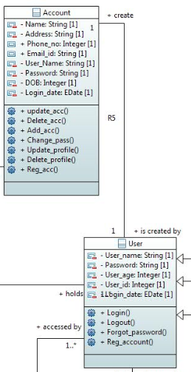
OCL Constraint
1. Every user must have a unique user id.
Context User
Inv: self.allinstances->for all (U1, U2 ->User, U1<>U2 Implies U1.User_id <> U2.User_id)
2. User must login once in 6 months in order keep his account active.
Context User: get_login(a: date)
Pre: self.logindate <= 6
Post: login date = logindate@pre +1

Slide 12
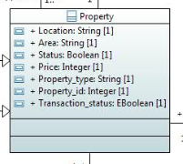
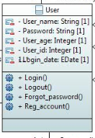
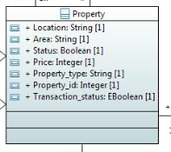
OCL Constraint
3. To manage property according to Status:
Status 1: The Property is “Available to sell”
Status 2: The Property is “Sold Out”
Context Property
Inv: self.status = if 1 then self.Available = true and self.soldout = false
else if status = if 2 then self.Available = false and self.soldout = true
endif
4. User should enter valid password credential at the time of Registration.
Context User
Inv: password = password.matches((?=.*\d)(?=.*[a-z])(?=.*[A-Z])(?=.*[@#$%]).{6,20})
5. Property always should valid status: available or soldout
Context Property
Inv: self.status() -> NotEmpty()

Slide 13
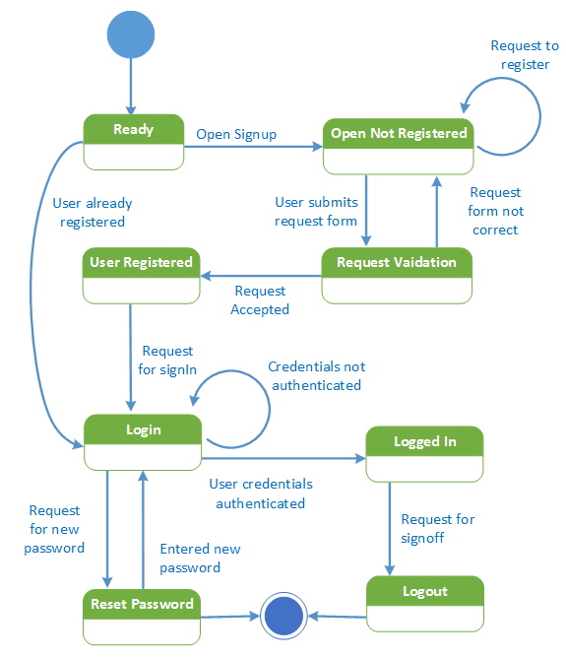
State Diagram 1- User Login

Slide 14
State Diagram 2 - Transaction

Slide 15
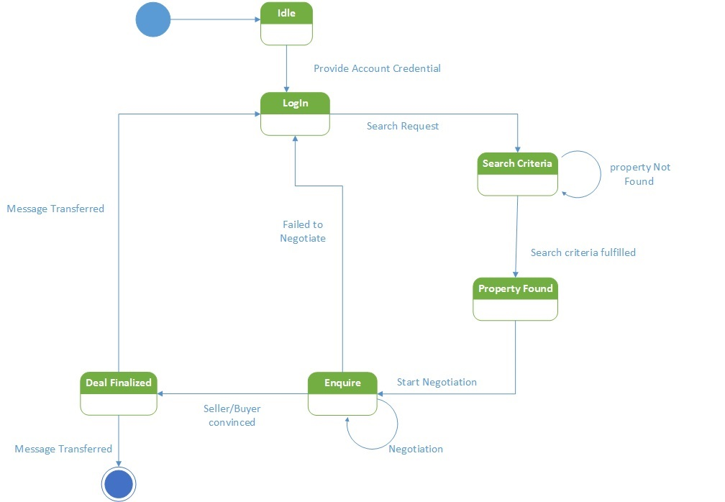
State Diagram 3- Enquiry

Slide 16
Action Specification
1. Creating a new Account and deleting the instance of the class Account.
2. Increasing the Price of property whose area is between 2000 sqfts and 5000 sqfts by 15%.
Create object instance newAccount of Account; // creates a new instance of the class Account called newAccount. newAccount.name = “Adam”; newAccount.emailid= “Adam.gmail.com”; newAccount.Login_date= “1st January 1956”; x = newAccount.name; // x gets the value of the name y = newAccount.emailid; // y gets the value of the email z = newAccount.Login_date; // z gets the value of the login date delete object instance newAccount // deletes the object newAccount
select many notSoNewProperty from instances of Property where selected.area < 5000 and selected.area > 2000; for each Property in notSoNewPropertys property.Price = property.Price * 1.15; // increase the price by 15% end for;

Slide 17

DEMONSTRATION

Slide 18
Tools Used
Tools | Purpose | Advantages | Limitations | OCL Support
Microsoft Visio | Use -Case Diagram, State Diagram | Ease of Learning, Small Learning Curve | Difficult to edit the model. (E.g.-resizing or adding new class) | No
Papyrus | Class Diagram | Extensive Documentation Available | Disabled additional plug-ins (E.g.- Incubation) | Yes
Eclipse IDE | Code Generation, Syntax Error Detection, Tool integration between server and Database | Extensive Documentation Available | Difficult to comprehend at initial state, Detects limited errors | Yes

Slide 19
Ease of Use V/S Learning Curve

Slide 20
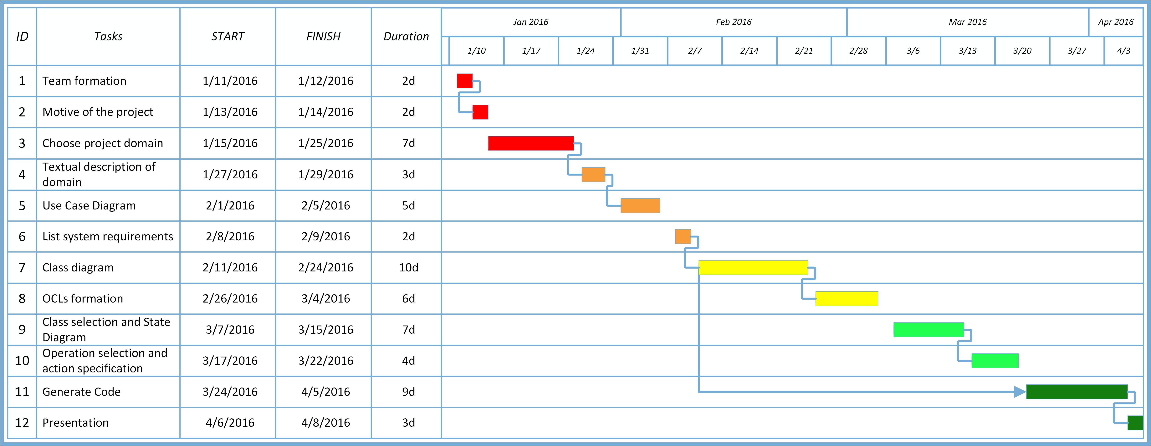
Gantt Chart
Deliverable 1
Deliverable 2
Deliverable 3
Deliverable 4
Deliverable 5

Slide 21

Collaboration
Medium | Use
Google Drive | Updating/Sharing documents
WhatsApp | Messaging
Email | Exchange of Documents
Github | Division of work/ Uploading deliverables and individual Work

Slide 22

Lesson Learnt and Challenges
Team work and collaboration
Experience and understanding at design level.
Acquired new Concepts : Generation of code from Model
Experience new tool- Papyrus.
But at the same time,
No concrete documentation for certain tools
Selection of best tools for diagrams was somehow sensitive
No Sample project available to study.

Slide 23

Conclusion
A lot of learning
Extensive knowledge about
Use case Diagram
Class Diagram
State Diagram
OCL Constraint
Action Semantics
Professionalism
Work ethics

Slide 24

Future Work
Extending the system to add new functionality
Security enhancement.
Improving all the concepts including Classes, Code enhancing, constraining precisely so as to keep the system more authenticated

Slide 25
Reference
State Diagram: http://en.wikipedia.org/wiki/State_diagram Action Semantic:
Executable UML: A Foundation for Model-Driven Architecture” by S. Mellor and M. Balcer- Chapter7
COEN6312 Winter 2016. Lecture notes
Structuring Use Cases with Goal http://www.uio.no/studier/emner/matnat/ifi/INF5120/v04/undervisningsmateriale/UseCases.pdf
Stakeholder Identification in the Requirements Engineering Process http://discovery.ucl.ac.uk/744/1/1.7_stake.pdf

Slide 26

THANK YOU

